Slide 1




Overview of AI Tools and Applications
Gil Speyer
Wednesday / Track 1
AI Workshop Denver, CO April 2-3, 2025

Slide 2

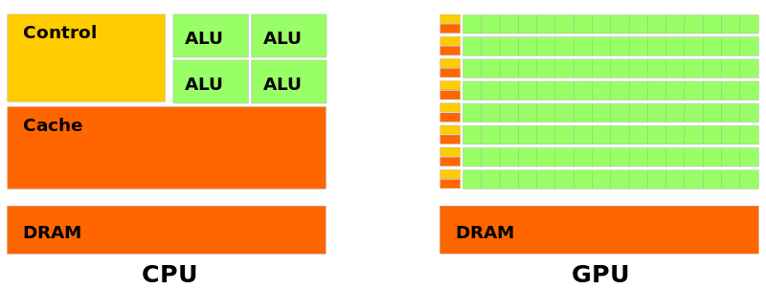
Graphics Processing Unit
Ample data
Regular computation.
medium.com

Slide 3
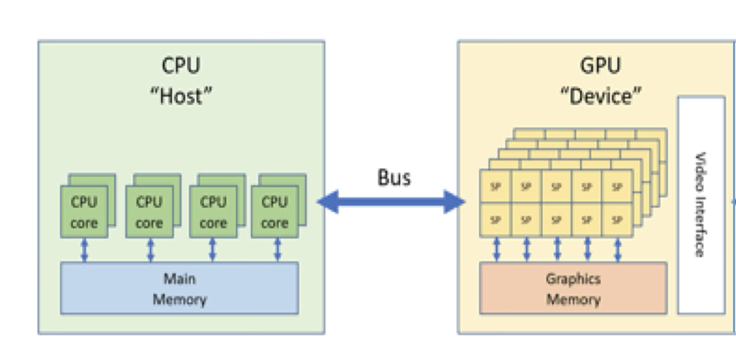
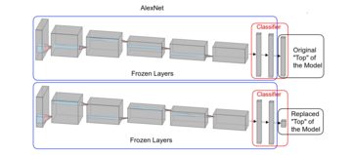
Graphics Processing Unit
AlexNet 2012
Trained on GPUs, taking days (vs months)
Image classification
Ideal for Deep learning
Linear operations
Large # parameters
Processing large batches
Single precision is sufficient
Ample data (e.g. the internet)
wikipedia.org

Slide 4
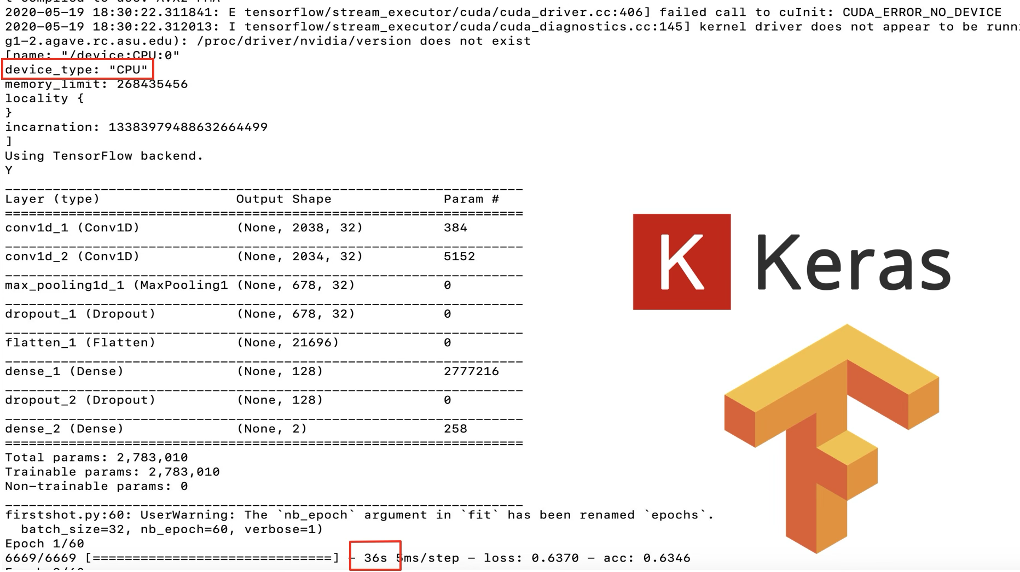
Aptos 28 pt black - Heading
Not only are GPU run times 12x faster than CPU for the same task…
Aptos 18 pt black Text Body

Slide 5
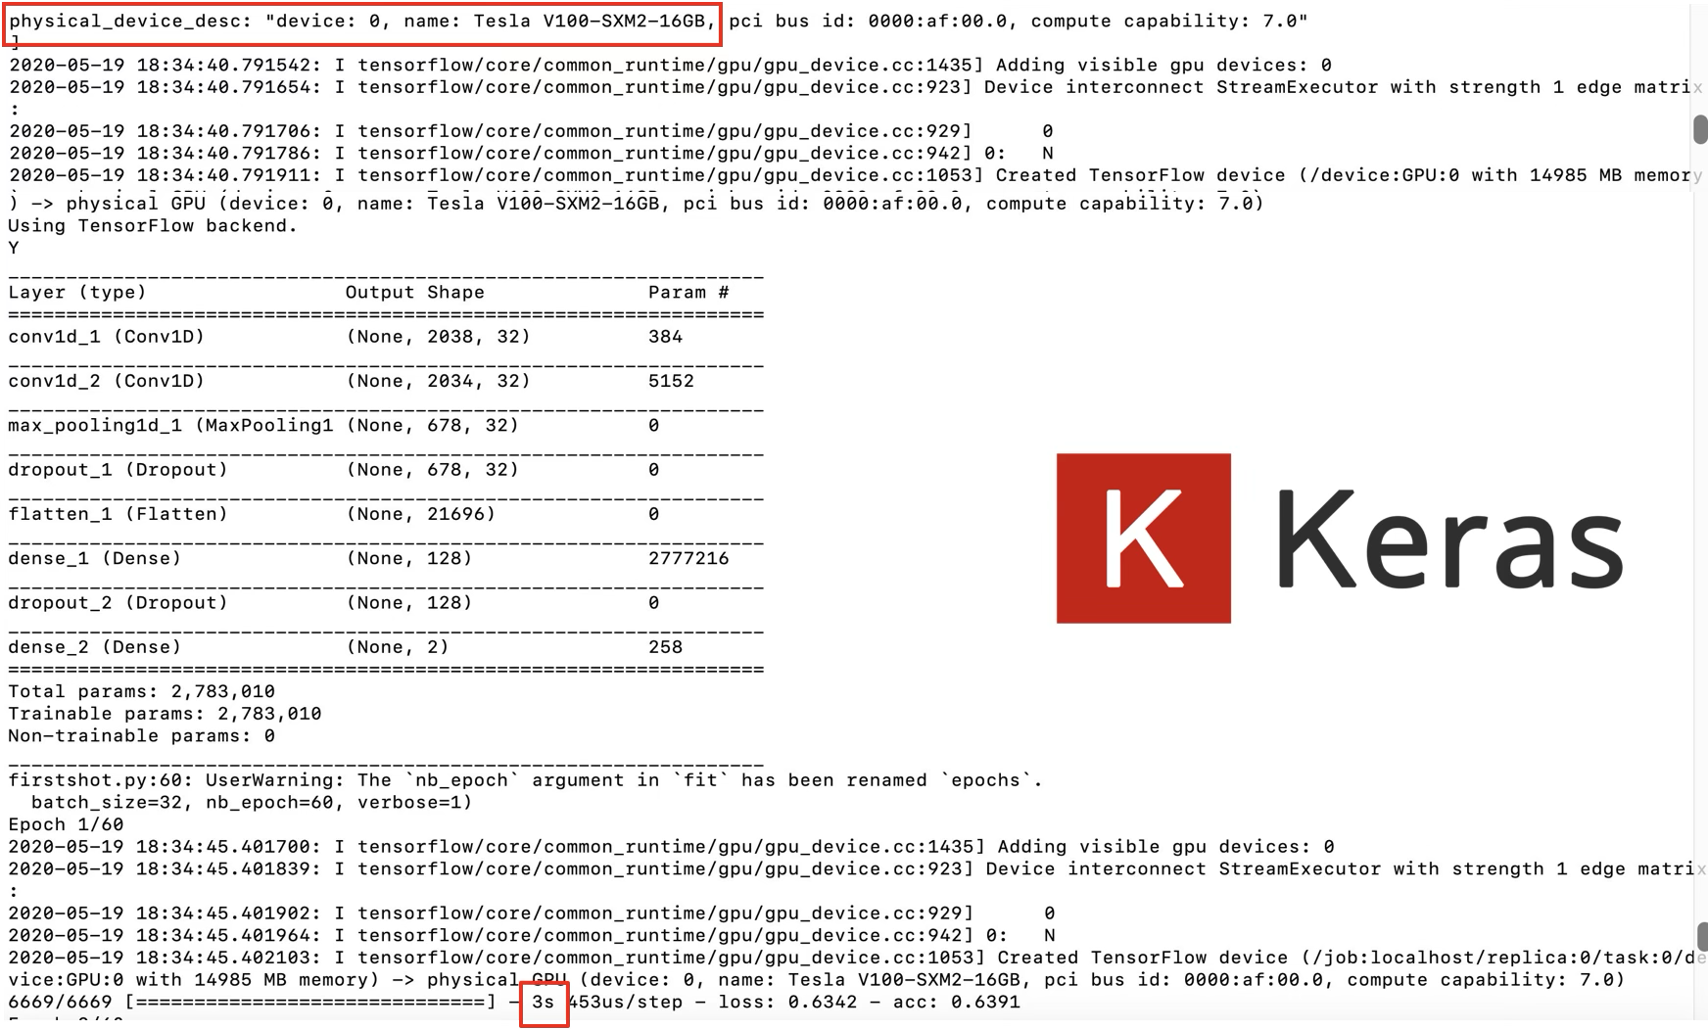
Aptos 28 pt black - Heading
Aptos 18 pt black Text Body
But also…automatically detects the device and sets the optimal configuration for you

Slide 6
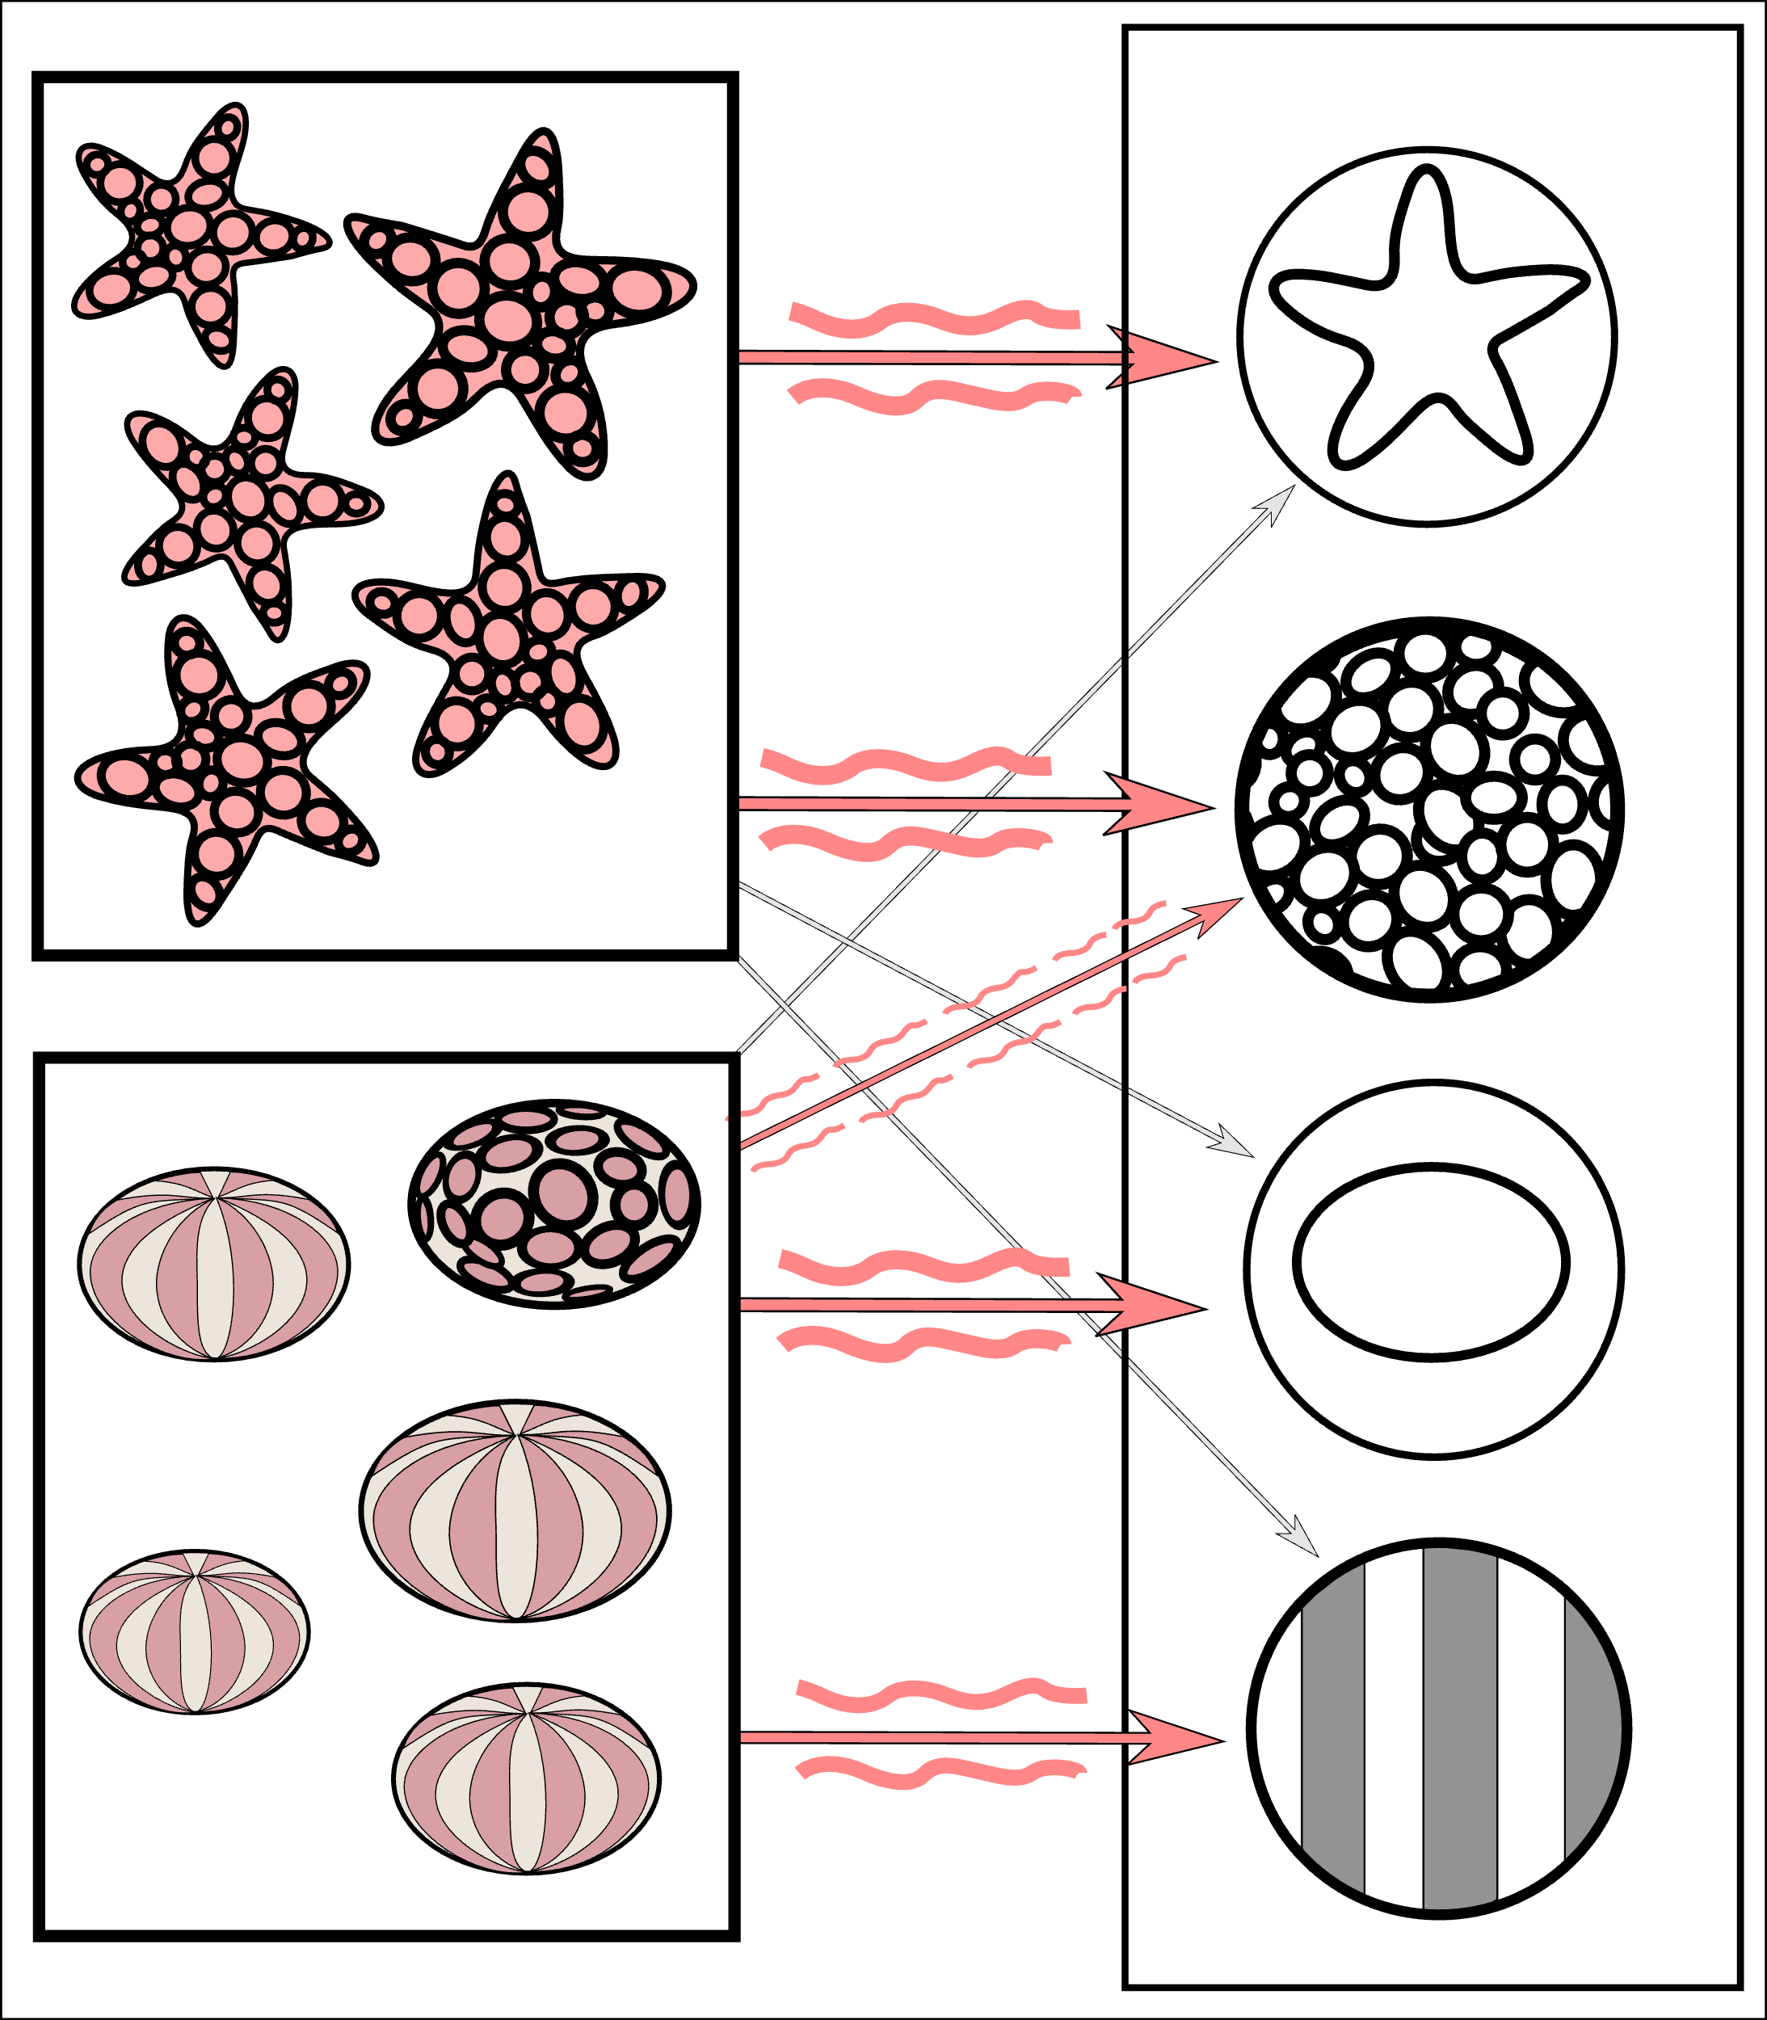
AI-based tools – “Perception AI”
Supervised learning – labeled datasets
Speech Recognition
wav2vec (Meta AI)
Whisper (OpenAI)
Images (e.g. medical)
Train / test / validate
wikipedia.org
Notes:
The starfish match with a ringed texture and a star outline, whereas most sea urchins match with a striped texture and oval shape. However, the instance of a ring textured sea urchin creates a weakly weighted association between them.

Slide 7



Open Source Tools for AI
Hugging Face – A hub for AI / ML models
TensorFlow (Google AI) , PyTorch (Meta AI)
training / inference of neural nets, NLP, CV
Both have ROCM support
Scikit-learn
ML library
cuML (Nvidia GPU implementation)
Mostly python but there is Torch for R

Slide 8
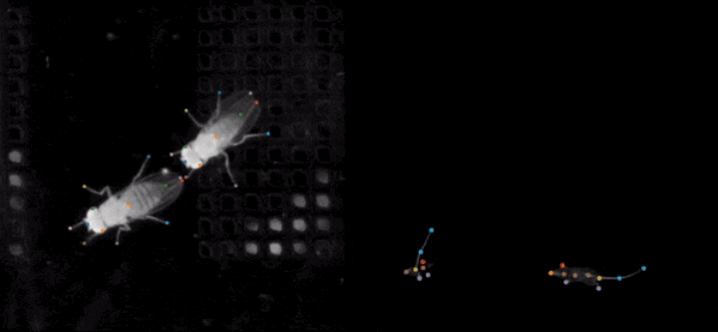
Aptos 28 pt black - Heading
SLEAP - Deep learning based multi-animal pose tracking
Aptos 18 pt black Text Body
Notes:
Label images using GUI

Slide 9
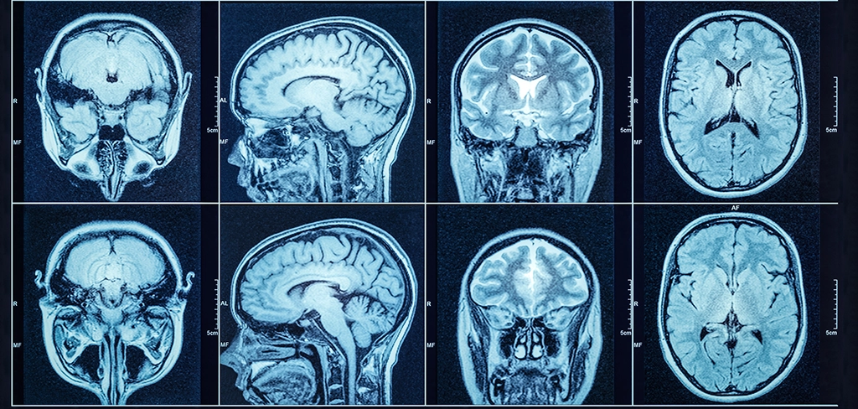

MONAI - Medical Open Network for AI
NVIDIA’s MONAI is a set of open-source, freely available collaborative frameworks built for accelerating research and clinical collaboration in Medical Imaging
MONAI Label – annotation,
MONAI Core – image transforms, segmentation
Python packages, NGC container: (search at catalog.ngc.nvidia.com)
sjra.com

Slide 10
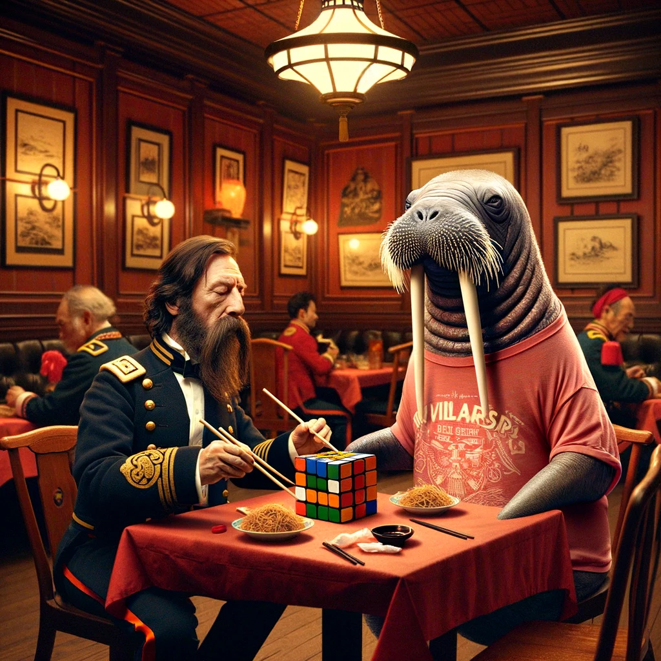
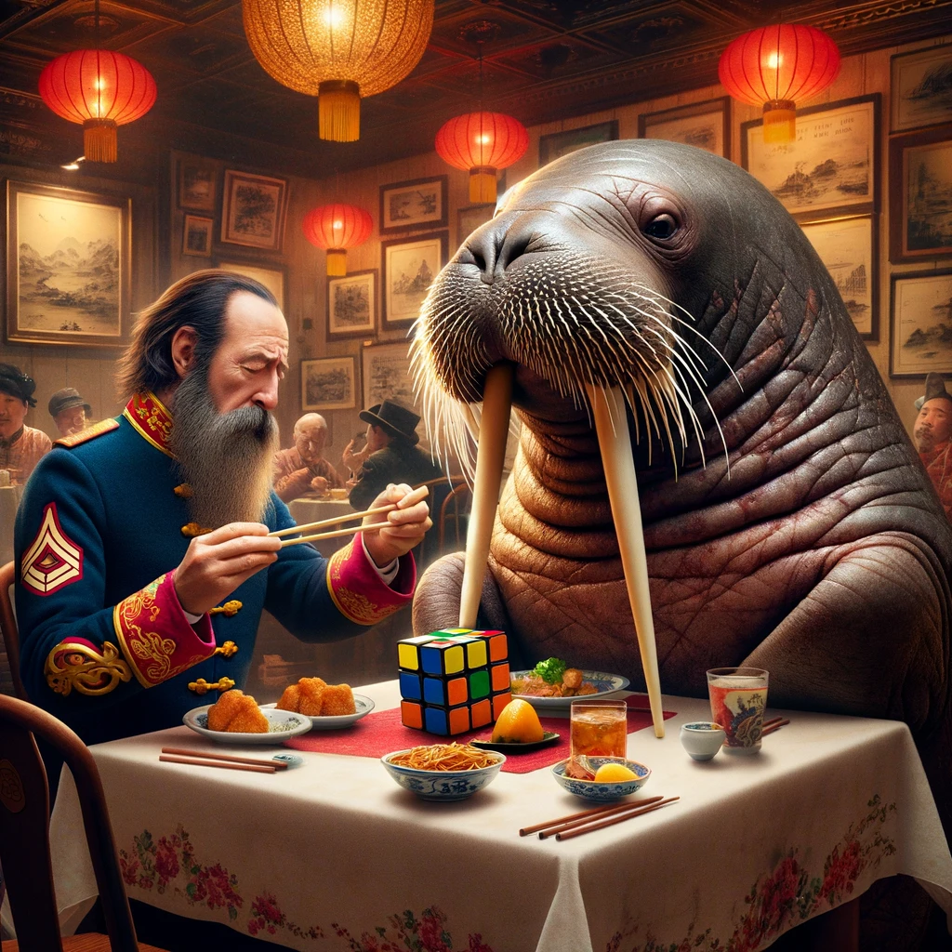
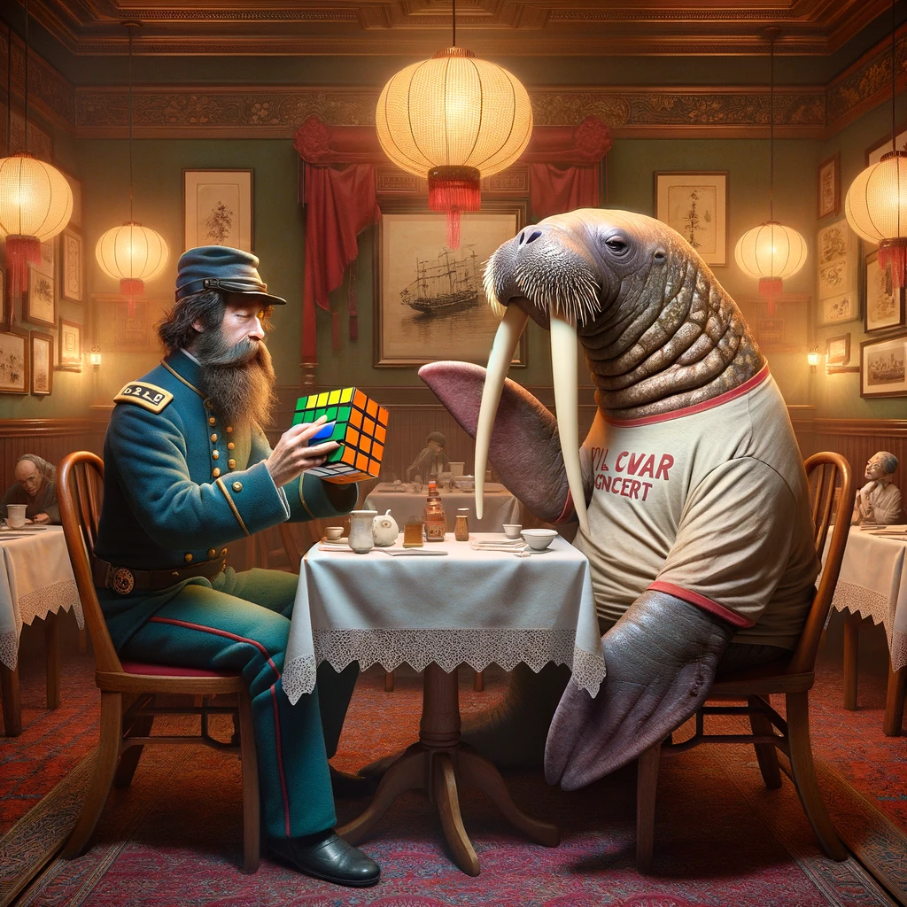
AI-based tools – “Generative AI”
Unsupervised learning – patterns learned from data
Output can be text, images, audio, video…
wikipedia.org

Slide 11
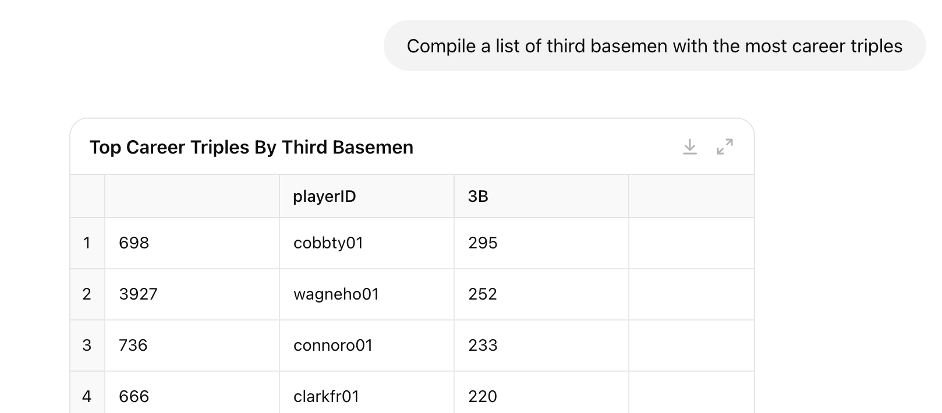
AI-based tools – “Generative AI”
# Merge all third base fielding records with batting to get career totals
third_base_players = third_base_fielding[['playerID']].drop_duplicates()
# Merge with batting data
third_base_batting = pd.merge(
third_base_players,
batting_df[['playerID', '3B']],
on='playerID',
how='left'
)
# Group by playerID and sum up triples
career_triples_by_third_basemen = (
third_base_batting.groupby('playerID')['3B']
.sum()
.reset_index()
.sort_values(by='3B', ascending=False)
)
# Show top 20 career triples by third basemen
top_career_triples_third_base = career_triples_by_third_basemen.head(20)
tools.display_dataframe_to_user(name="Top Career Triples by Third Basemen",
dataframe=top_career_triples_third_base)
Code generation
Chatgpt Example:
Uploaded baseball fielding and hitting datafiles
Notes:
The starfish match with a ringed texture and a star outline, whereas most sea urchins match with a striped texture and oval shape. However, the instance of a ring textured sea urchin creates a weakly weighted association between them.

Slide 12
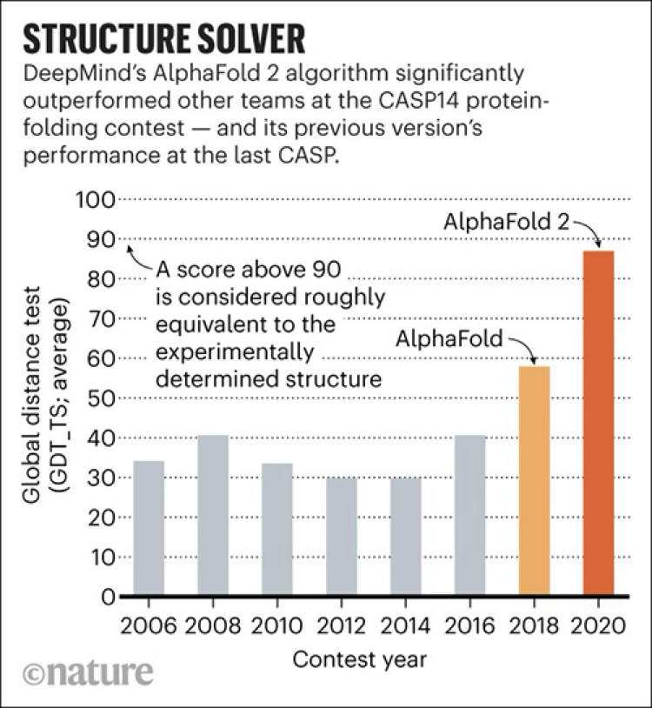
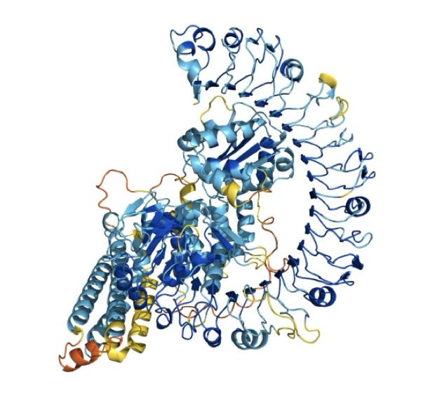
AlphaFold3
A GPU-based Machine Learning method for protein structure prediction
Structure databases in directory
Run with apptainer image
Upload json input file

Slide 13
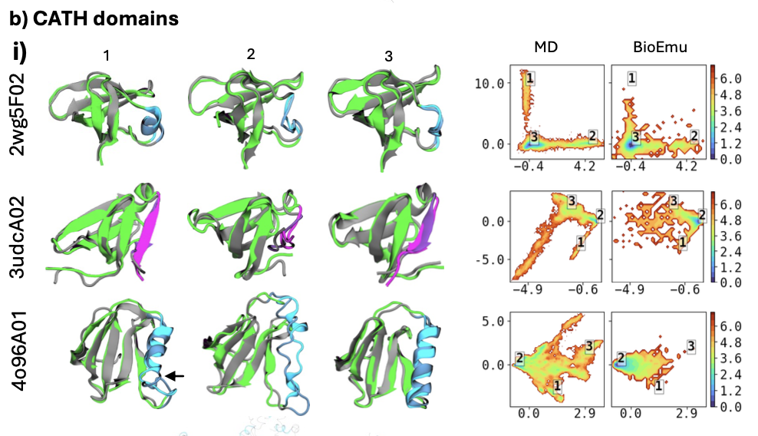
BioEmu
Determine dynamic behavior (conformational states) of proteins toward understanding function
Trained on MD simulation data, database of structures, and experimental measurements of protein stability.

Slide 14
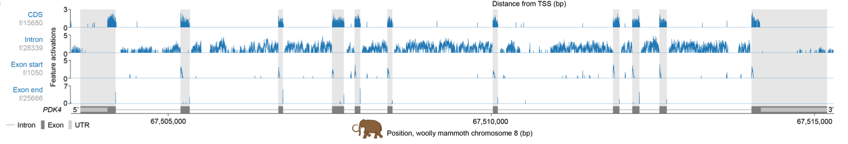
Evo2
Trained on trillions of base pairs across multiple species
Autonomous learning features
Exon/intron boundaries
Transcription factor binding sites
Protein structural elements
Prophage genomic regions
Predicts mutation effects
Gene completion
Mitochondrial genome generation
Generative epigenomics
Notes:
Transcription start site, CDS coding region

Slide 15

Industry Tools and Offerings
MS Azure AI
Speech recognition, speaker recognition, neural speech synthesis, face recognition, computer vision, OCR/form understanding, natural language processing, machine translation
Azure AI studio for building/ deploying LLMs such as GPT-4o
copilot

Slide 16
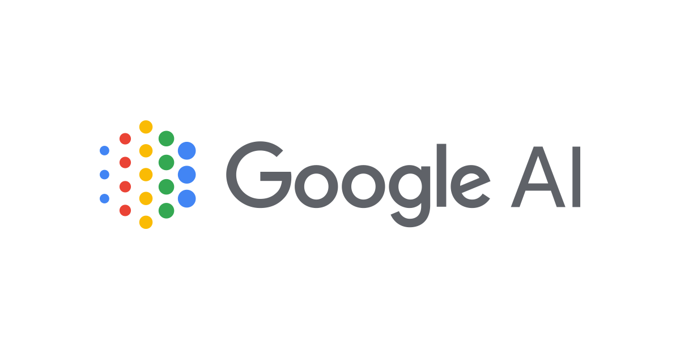
Industry Tools and Offerings
Google AI
Gemini
Video, images, pdf, audio
1, 1.5, 2 have different rates & vary w # tokens
notebooklm.google.com

Slide 17

Industry Tools and Offerings
Amazon AI Services
Anthropic
Claude sonnet 3.5
Nova foundation models (light, mini, pro)
Mistral

Slide 18
Access and Integration
Accessing open source tools
Download from repo
Submit ticket for install
Accessing industry tools
Free tier options
Licensing requirements

Slide 19


Access and Integration – AI Workflows in HPC
Interactive – Direct interaction with models (local or cloud)
Batch – Submit jobs to scheduler. Enables large-scale
API – Application Program Interface. Means to interact with models in the cloud
Containers – Code and its dependencies packaged into a single self-contained unit

Slide 20
Conclusion
Agentic AI – research assistant, customer service
Physical AI – robotics, autonomous vehicles
Not an exhaustive list of tools
Thank you for your interest!

